Slide 1
Resume Building

Slide 2



Résumé
YOUR TICKET TO AN INTERVIEW.

Slide 3

Topics
1. The Importance of Resume
2. Difference between CV and Resume
3. Things to include in resume
4. Format and Sample resume

Slide 4
Objective
Upon successful completion of this topic students will learn to write a resume showing their skills, experiences, and scholastics that they will use once applying for employment, a scholarship, or college.

Slide 5
Evolution
1482 - Leonardo Da Vinci writes the first professional resume.
Resumes were just formalities. Most wrote them on scraps of paper over lunch with employers.

Slide 6
Evolution
Resumes are no longer just formalities; they are now expected. Resumes start to include outside interests like sports and hobbies. Word processors make resumes more professional.
2003 - LinkedIn is launched.
2006 - Video resumes pick up.

Slide 7
What is Resume & its purpose?
A resume (also spelled résumé) is an overview about who you are!
Resume is a French word which means summary. Resume is nothing but an overall summary of yourself. It’s a tool to advertise yourself.
Its goal is to capture the reader’s interest.
Most resumes only get 20-30 seconds to be scanned by the reader.
It MUST have enough IMPACT to GRAB the ATTETION of the prospective EMPLOYER.

Slide 8
The Importance of resume building
Resume is nothing but aspirant’s brief introduction
Tool for selling your skills
To showcase your creativity
You are sure of your work

Slide 9
Resume, CV, Portfolio & Biodata
• Curriculum Vitae
-For an experienced candidate
-Detailed information on the person's experience
• Portfolio
-For artists — will have visual records of their works
-Example: Models will carry photos and videos of their photo shoots and ramp walks

Slide 10
Resume, CV, Portfolio & Biodata
• Biodata
-Biological data — details on physicality and health
-Interviews where health and physicality are necessary.
-Example: Army interview, police selection
• Resume
-French word which means summary
-For a fresher Should not be more than or less than 2 pages

Slide 11
Things to include in Resume
1. Personal Information
Top left
-Name
-Residential address below the name
Top middle
-Mobile number
-E-mail id below the mobile number
Top right
-Passport size photograph

Slide 12
Things to include in Resume
2. Career objective
It should be phrase which comprises of:
- Aspirants position in organization
- Aspirants profession
- Modern technology
- Challenges
Example: “To get a job as a junior programmer in an IT firm and gain as much as possible in the field. And, to apply what I gained when confronted by challenges”

Slide 13
Things to include in Resume
3. Scholastics (Academic details)
Always write your educational details in reverse chronological order.
Always start with your most recent qualification first.
Aspirants need to include Name of the college/university, Degree you earned or working on it, passing year, Percentages (%, CGPA etc.)
If possible, write this in table format.

Slide 14
Things to include in Resume
4. Technical skills/ computer skills
Core companies:
1. Mechanical Engineering:
AutoCAD
ProE
Hypermesh
Ansys
2. Electronics & Telecommunication
MATLAB/ORCAD/Embedded C
IT COMPANIES:
C/C++/JAVA/.NET
Operating system :
Wrong answers: windows 7 or 8, iOS
Right answers: Red Hat Linux, ubuntu 14.04

Slide 15
Things to include in Resume
5. Project details
Project title | Technology used | Project duration | Description
Automation of solar panel | Devices- PIC, Photovoltaic sensors, Solar panel Programming language- Embedded C | 6 months-from January 2014-june 2014 | Tracking the sun and ensuring 90-degree incidence on the solar panel to generate maximum electricity. Won best project award at techtonic 2014 at parul university.

Slide 16
Things to include in Resume
6. Achievements
This is not a mandatory section. You can mention your district, state, or national level achievement in this section. field can be anything. You can also mention your college level achievement here, but it should be at least intra college level.

Slide 17
Things to include in Resume
7. Co-curricular activities
Includes paper presentations, seminars and any technical event like technical quiz.
Format: Presented the paper titled "paper title" at event name — college name on Date Month, Year.
Or
Won the 1" or 2nd or 3'd prize or "The Best Project Award" for the project "paper title" at symposium name — college name on Date Month, Year.

Slide 18
Things to include in Resume
8. Extra-curricular activities
In this section you can include your following achievements:
• Singing, dancing or any art — certificates necessary
• Contributions through NGOs
• Involvement in organizations
• Organizing events — certificates necessary

Slide 19
Things to include in Resume
9. Hobbies
Kindly mention those hobbies which should contribute to a person's intellectual growth.
Wrong examples: Watching TV, Listening to Music, Tennis, Chatting with friends, Browsing.
Right examples: Watching NEWS and Documentary Channels Listening to or Playing Western Classical Music or Carnatic Music or Hindustani Music, Singing, Dancing Following Tennis or Playing Tennis, Reading Novels, Gardening, Cooking.

Slide 20
Things to include in Resume
10. Personal Details
• Year of birth
• Sex
• Nationality
• Fathers name
• Fathers occupation
• Mothers name
• Mothers occupation

Slide 21
Format
There is no fixed format for resume, but here we are mentioning some guidelines which can be beneficial for you while making a resume.
• You can use any font which is neat and formal (e.g. Calibri, Arial, Times new roman).
• Font:
Name and Heading: 14
Others: 12

Slide 22
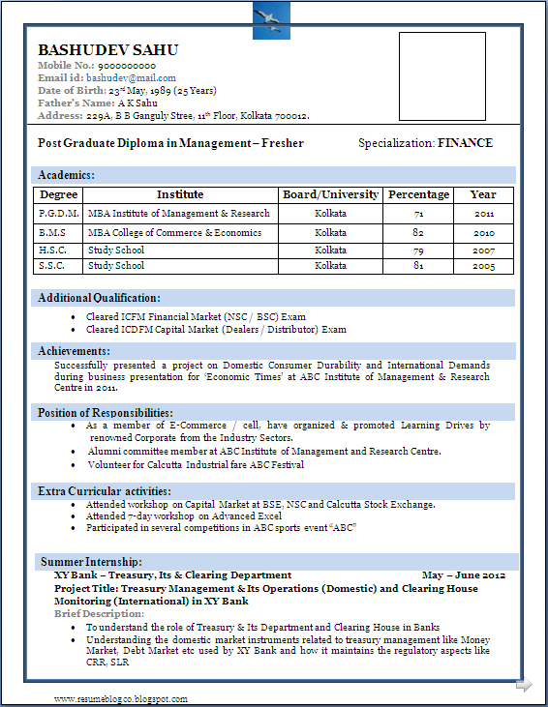
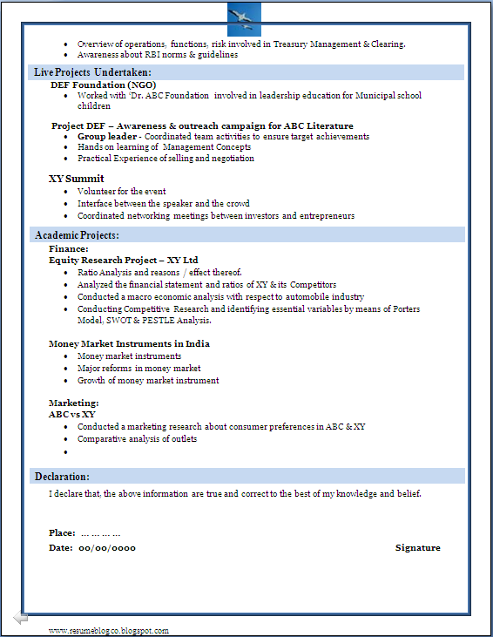
Sample

Slide 23

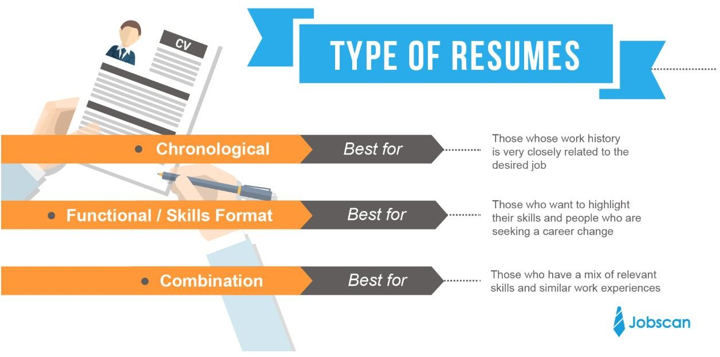

Types of Resumes

Slide 24
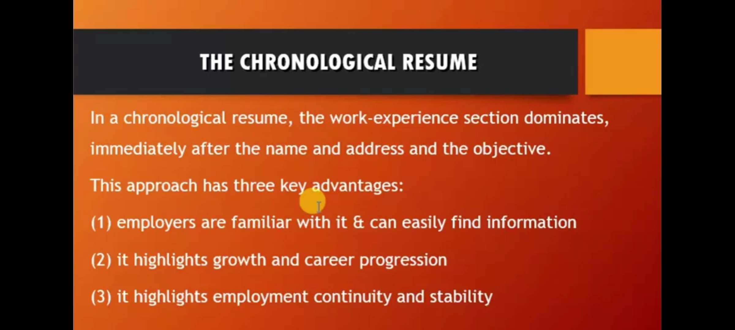

Slide 25
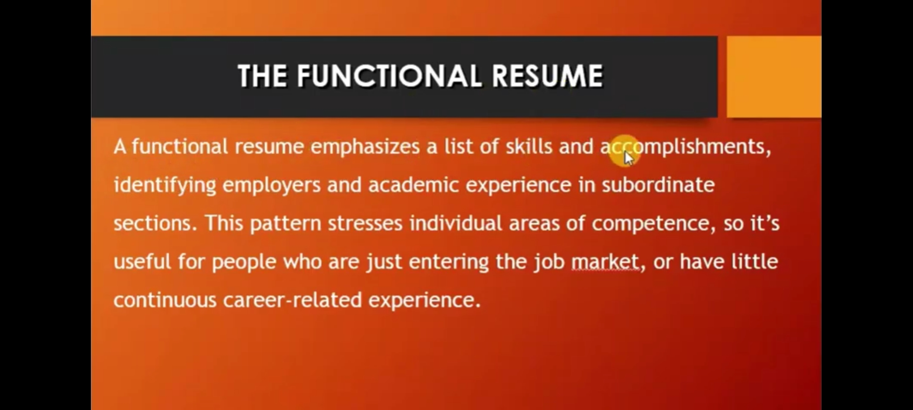

Slide 26
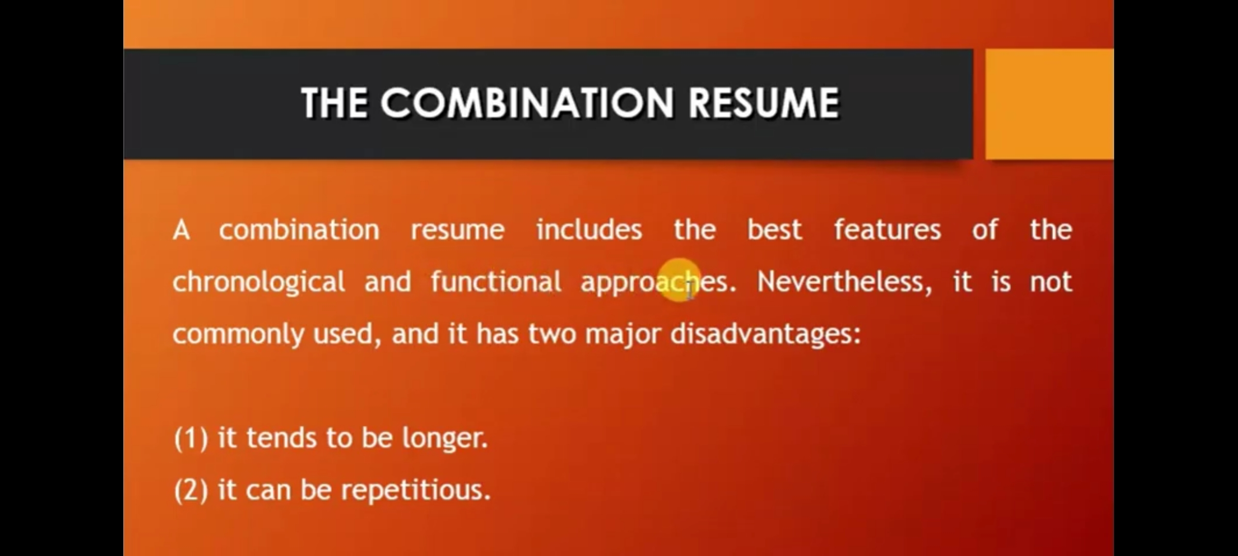

Slide 27


